Slide 1
ASP.NET Web Api
https://www.interviewbit.com/web-api-interview-questions/#use-of-httpresponsemessage-in-webapi

Slide 2
What is ASP.NET Web API?
ASP.NET Web API is a framework provided by Microsoft with which we can easily build HTTP services that can reach a broad of clients, including browsers, mobile, IoT devices, etc. ASP.NET Web API provides an ideal platform for building RESTful applications on the .NET Framework.

Slide 3
What are the advantages of using ASP.NET Web API?
Some of the core advantages of using ASP.NET Web API are given below:
It provides the best platform for developing RESTful applications on .NET Framework.
It works the same way that HTTP works with help of HTTP verbs such as GET, POST, PUT, DELETE for all crud operations.
It provides enough flexibility in Web API creation.
It completely supports routing.
It also supports model binding, validation, Odata (Open Data Protocol) that allows creation and consumption of RESTful APIs.
It has the ability to develop custom help and test pages with help of ApiExplorer.
One can develop non-SOAP-based services such as plain XML, JSON strings, etc.
It also increases the TDD (Test Data-Driven) approach in the development of RESTful services.

Slide 4
What is the difference between ASP.NET Web API and WCF?
Web API is a Framework to build HTTP Services that can reach a board of clients, including browsers, mobile, IoT Devices, etc. and provided an ideal platform for building RESTful applications. It is limited to HTTP based services. ASP.NET framework ships out with the .NET framework and is Open Source.
WCF i.e. Windows Communication Foundation is a framework used for building Service Oriented applications (SOA) and supports multiple transport protocol like HTTP, TCP, MSMQ, etc. It supports multiple protocols like HTTP, TCP, Named Pipes, MSMQ, etc. WCF ships out with the .NET Framework. Both Web API and WCF can be self-hosted or can be hosted on the IIS Server.

Slide 5
When to prefer ASP.NET Web API over WCF?
It totally depends upon the requirement. Choose ASP.NET Web API is you want only HTTP based services only as Web API is a lightweight architecture and is good for the devices which have limited bandwidth. We can also create the REST services with the WCF, but that requires lots of configuration. In case, if you want a service that should support multiple transport protocol like HTTP, UDP, TCP, etc. then WCF will be a better option.

Slide 6
Which .NET Framework supports ASP.NET Web API?
First Version of ASP.NET Web API is introduced in .NET Framework 4. After that, all the later versions of the .NET Framework supports the ASP.NET Web API.

Slide 7
Can we consume ASP.NET Web API in applications created using other than .NET?
Yes, we can consume ASP.NET Web API in the applications created using another language than .NET but that application must have access/supports to the HTTP protocol.

Slide 8
What is the difference between ASP.NET MVC application and ASP.NET Web API application?
ASP.NET MVC is used to create a web application which returns both data as well as View whereas Web API is used to create HTTP based Services which only returns data not view. In an ASP.NET MVC application, requests are mapped to Action Methods whereas in the ASP.NET Web API request is mapped to Action based on the Action Verbs.
MVC | Web API
It can be used to build Web applications that reply as both data and views. | It is used to build HTTP services that reply only as data.
It returns data in JSON format by using JSONResult. | It returns data in different formats such as JSON, XML, etc.
It supports content negotiation, self-hosting. | It does not support content negotiation, self-hosting.
It is not able to build REST-full services. | It is very helpful in creating REST-full services.
It returns a view (HTML). | It returns REST responses.

Slide 9
What are the RESTful Services?
REST stands for the Representational State Transfer. This term is coined by the Roy Fielding in 2000. RESTful is an Architectural style for creating loosely couple applications over the HTTP. In order to make API to be RESTful, it has to adhere the around 6 constraints that are mentioned below:
Client and Server Separation: Server and Clients are clearly isolated in the RESTful services.
Stateless: REST Architecture is based on the HTTP Protocol and the server response can be cached by the clients, but no client context would be stored on the server.
Uniform Interface: Allows a limited set of operation defined using the HTTP Verbs. For eg: GET, PUT, POST, Delete etc.
Cacheable: RESTful architecture allows the response to be cached or not. Caching improves performance and scalability.
Code-On-Demand
Layered System

Slide 10
What are the new features introduced in ASP.NET Web API 2.0?
The following features have been introduced in ASP.NET Web API 2.0:
Attribute Routing
CORS (Cross-Origin Resource Sharing)
OWIN (Open Web Interface for .NET) self-hosting
IHttpActionResult
Web API OData etc.

Slide 11
Can we return View from Web API?
No, Web API does not return View but they return the data. APIController is meant for returning the data. So, if you need to return a view from the controller class, then make sure to use or inherit the Controller class.

Slide 12
Does ASP.NET Web API replace the WCF?
No, ASP.NET Web API didn’t replace WCF Service as it is only used for creating RESTful Service i.e. non-SOAP based service.

Slide 13
What is Request Verbs or HTTP Verbs?
In RESTful service, we can perform all types of CRUD (Create, Read, Update, Delete) Operation. In REST architecture, it is suggested to have a specific Request Verb or HTTP verb on the specific type of the call made to the server. Popular Request Verbs or HTTP Verbs are mentioned below:
HTTP Get: Used to get or retrieve the resource or information only.
HTTP Post: Used to create a new resource on the collection of resources.
HTTP Put: Used to update the existing Response
HTTP Delete: Used to Delete an existing resource.

Slide 14
What are HTTP Status Codes?
HTTP Status Code Is 3-digit integer in which the first digit of the Status-Code defines the class of response. Response Header of each API response contains the HTTP Status Code. HTTP Status Codes are grouped into five categories based upon the first number.
S. No. | HTTP Status Code | Description
1 | 1XX | Informational
2 | 2XX | Success
3 | 3XX | Redirection
4 | 4XX | Client-Side Error
5 | 5XX | Server-Side Error

Slide 15
What is Parameter Binding in ASP.NET Web API?
When Web API calls a method on a controller, it must set the values for the parameters, this particular process is known as Parameter Binding. By Default, Web API uses the below rules in order to bind the parameter:
FromUri: If the parameter is of “Simple” type, then Web API tries to get the value from the URI. Simple Type includes.Net Primitive type like int, double, etc., DateTime, TimeSpan, GUID, string, any type which can be converted from the string type.
FromBody: If the parameter is of “Complex” type, then Web API will try to bind the values from the message body.

Slide 16
What is Content Negotiation in Web API?
Content Negotiation is the process of selecting the best representation for a given response when there are multiple representations available. Two main headers which are responsible for the Content Negotiation are:
Content-Type
Accept
The content-type header tells the server about the data, the server is going to receive from the client whereas another way to use Accept-Header, which tells the format of data requested by the Client from a server. In the below example, we requested the data from the server in JSON format.

Slide 17
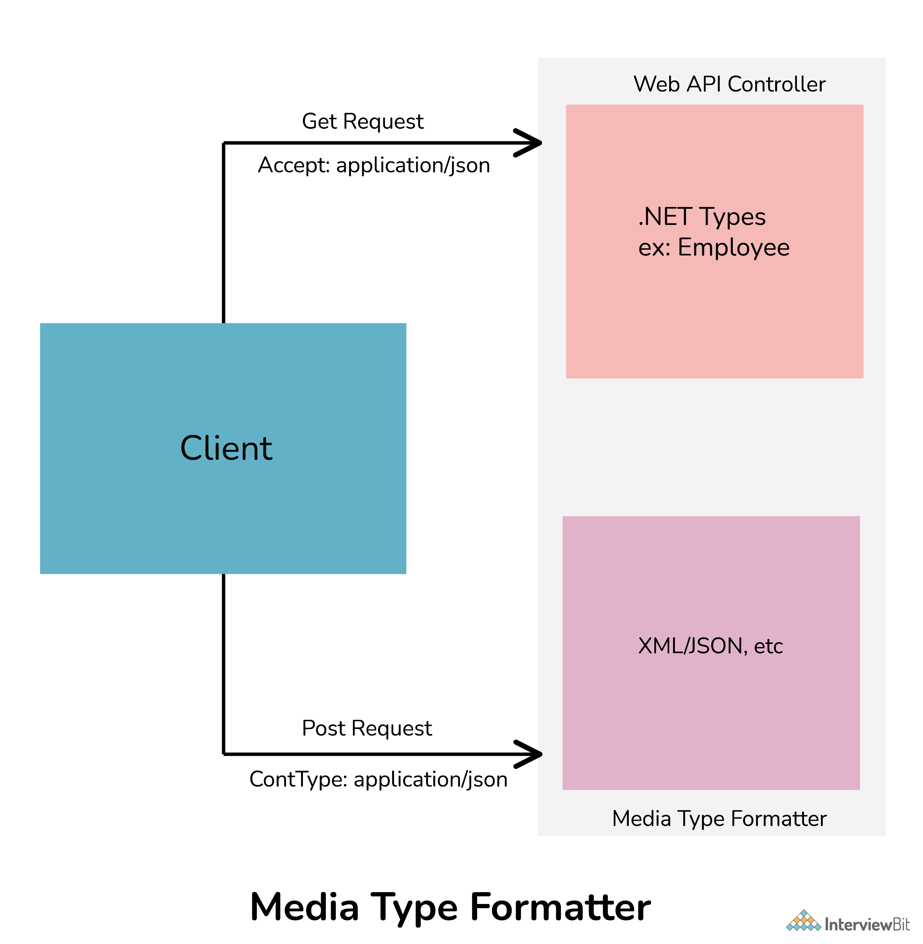
What is Media-Type Formatter in ASP.NET Web API?
In web API, media type formatters are classes that are responsible for serialization data. Here, serialization generally means a process of translating data into a format that can be transmitted and reconstructed later. Because of serializing request/response data, Web API can understand request data format in a better way and send data in a format that the client expects. It simply specifies data that is being transferred among client and server in HTTP response or request.
Media Type Formatter Class | MIME Type | Description
JsonMediaTypeFormatter | application/json, text/json | Handles JSON format
XmlMediaTypeFormatter | application/xml, text/json | Handles XML format
FormUrlEncodedMediaTypeFormatter | application/x-www-form-urlencoded | Handles HTM form URL-encoded data
JQueryMvcFormUrlEncodedFormatter | application/x-www-form-urlencoded | Handles model-bound HTML form URL-encoded data

Slide 18
What is the use of Authorize Attribute?
Web API provided a built-in authorization filter, i.e. Authorize Attribute. This filter checks whether the user is authenticated or not. If not, the user will see 401 Unauthorized HTTP Status Code.

Slide 19
What is Basic HTTP Authentication?
Basic HTTP Authentication is a mechanism, where the user is authenticated through the service in which the client pass username and password in the HTTP Authorization request headers. The credentials are formatted as the string “username:password”, based encoded.

Slide 20
How Web API Routes HTTP request to the Controller ASP.NET MVC?
In ASP.NET Web API, HTTP request maps to the controller. In order to determine which action is to invoke, the Web API framework uses a routing table.

Slide 21
In How many ways we can do Web API Versioning?
We can do Web API Versioning in the following ways:
URI
Query String Parameter
Custom Header Parameter
Accept Header Parameter

Slide 22
What is Exception handling?
Exception handling is a technique to handle runtime error in the application code. In multiple ways we can handle the error in ASP.NET Web API, some of them are listed below:
HttpResponseException
HttpError
Exception Filters etc.

Slide 23
What is different between REST API and RESTful API?
REST API | RESTful API
REST is an architectural pattern used for creating web services. | RESTful API is used to implement that pattern.
The data format of REST is based on HTTP. | The data format of RESTful is based on JSON, HTTP, and Text.
Working of URL is based on request and response. | Working of RESTful is based on REST applications.
It is more user-friendly and highly adaptable to all business enterprises and IT. | It is too flexible.
It is required to develop APIs that allow interaction among clients and servers. | It simply follows REST infrastructure that provides interoperability among different systems on the whole network.

Slide 24
What is REST and SOAP? What is different between them?
REST (Representational State Transfer): It is a new and improved form of web service. It describes the architectural style of networked systems. It does not require greater bandwidth when requests are sent to the server. It just includes JSON message. For example:
{"city":"Mumbai","state":"Maharashtra"}
SOAP (Simple Object Access Protocol): It is a simple and lightweight protocol that is generally used for exchanging structured and typed information on the Web. It works mostly with HTTP and RPC (Remote Procedure Call). This protocol is mainly used for B2B applications one can define a data contract with it. SOAP messages are heavier in content and therefore use greater bandwidth.
<?xml version="1.0"?>
<SOAP-ENV:Envelope xmlns:SOAP-ENV="http://www.w3.org/2001/12/soap-envelope" SOAP-ENV:encodingStyle=" http://www.w3.org/2001/12/soap-encoding">
<soap:Body>
<Demo.guru99WebService xmlns="http://tempuri.org/"> <EmployeeID>int</EmployeeID>
</Demo.guru99WebService>
</soap:Body>
</SOAP-ENV:Envelope>

Slide 25
REST vs SOAP
REST | SOAP
It is basically an architectural pattern. | It is basically a messaging protocol.
It usually works with various text formats such as plain text, HTML, JSON, XML, etc. | It only works with XML formats.
It is totally stateless. | It has some specifications for both stateless and stateful implementation.
Its performance is faster as compared to SOAP. | Its performance is slower as compared to REST.
It uses XML and JSON to send and receive data. | It uses WSDL (Web Service Description Language) for communication among consumers or users and providers.
REST has to resend transfer whenever it determines any errors. | SOAP includes built-in error handling for communications errors using WS-ReliableMessaging specification.
It calls services using the URL path. | It calls services by calling RPC (Remote Procedure Call) Method.

Slide 26
Web API supports which protocol?
Web API generally supports only HTTP protocol.

Slide 27
Which of the following Open-source libraries is used by WEB API for JSON serialization?
Json.NET library is generally used by Web API for JSON serialization.

Slide 28
What is XML and JSON?
XML (Extensible Markup Language):
It is especially designed to store and transport data.
It is similar to HTML but is more flexible than HTML because it allows users to create their own custom tags.
It is used for representing structured information such as documents, data, configuration, etc.
JSON (JavaScript Object Notation):
It is a lightweight format designed to store and transport data.
It is easier to understand and is a standard text-based format used for representing structured data based on JavaScript object syntax.
It is faster and easier to use.

Slide 29
What are Web API filters?
Filters are basically used to add extra logic at different levels of Web API framework request processing. Different types of Web API filters are available as given below:-
Authentication Filter: It handles authentication and authenticates HTTP requests. It also helps to authenticate user detail. It checks the identity of the user.
Authorization Filter: It handles authorization. It runs before controller action. This filter is used to check whether or not a user is authenticated. If the user is not authenticated, then it returns an HTTP status code 401 without invoking the action.
AuthorizeAttribute is a built-in authorization filter provided by Web API.
Action Filter: It is attributing that one can apply to controller action or entire controller. It is used to add extra logic before or after controller action executes. It is simply a way to add extra functionality to Web API services.
Exception Filter: It is used to handle exceptions that are unhandled in Web API. It is used whenever controller actions throw an unhandled exception that is not HttpResponseException. It will implement an “IExceptionFilter” interface.
Override Filter: It is used to exclude specific action methods or controllers from the global filter or controller level filter. It is simply used to modify the behavior of other filters for individual action methods.

Slide 30
How to handle errors in Web API?
Web API generally provides greater flexibility in terms of handling errors. Exception handling is a technique that is used to handle run-time errors in application code. One can use HttpResponseException, HttpError, Exception filters, register exception filters, Exception handlers to handle errors. Exception filter can be used to identify unhandled exceptions on actions or controllers, exception handlers can be used to identify any type of unhandled exception application-wide, and HttpResponseException can be used when there is the possibility of an exception.

Slide 31
How to register an exception filter globally?
One can register exception filter globally using following code:
GlobalConfiguration.Configuration.Filters.Add (new MyTestCustomerStore.NotImplExceptionFilterAttribute());

Slide 32
What is the use of HttpResponseMessage?
It is used to set response values such as header and status control. It simply allows us to work with HTTP protocol. It represents HTTP response messages that encapsulate data and status code.
// GetEmployee action
public HttpResponseMessage GetEmployee(int id)
{
Employee emp = EmployeeContext.Employees.Where(e => e.Id == id).FirstOrDefault();
if (emp != null) {
return Request.CreateResponse<Employee>(HttpStatusCode.OK, emp);
} else
{
return Request.CreateErrorResponse(HttpStatusCode.NotFound, "Employee Not Found");
}
}

Slide 33
What is the difference between ApiController and Controller?

Slide 34
What are the main return types supported in ASP. Net Web API?
It supports the following return types:
HttpResponseMessage
IHttpActionResult
Void
Other types such as string, int, etc.

Slide 35
What is ASP.NET Web API routing?
Routing is the most important part of ASP.NET Web API. Routing is a way how Web API matches a URI to an action. It is basically a process that decides which action and controller should be called. The controller is basically a class that handles all HTTP requests. All public methods of controllers are basically known as action methods or just actions. Whenever a Web API framework receives any type of request, it routes that request to action.
There are basically two ways to implement routing in Web API as given below: Convention-based routing: Web API supports convention-based routing. In this type of routing, Web API uses route templates to select which controller and action method to execute. Attribute-based routing: Web API 2 generally supports a new type of routing known as attribute routing. As the name suggests, it uses attributes to define routes. It is the ability to add routes to the route table via attributes.

Slide 36
HOW to secure ASP.NET Web API?
Web API has become key to programming web-based interactions. It can be accessed by anyone who knows the URL. Therefore, they have become targets for hackers. One needs to secure Web API by controlling Web API and by deciding who can and who cannot have access to Web API. There are basically two ways or techniques that make our Web API more secure. Authentication: It is a process that helps to identify and check users by their credentials such as password, username, etc. To have access to the web API, firstly user credentials are needed to be passed in the request header. If user credentials are not passed into the request header, then the server returns 401 status code (unauthorized). The best authentication to be used is OAuth 2.0. Authorization: It is a process that helps to decide whether or not a user has access to perform an action. Authorization filters are used to implement authorization.

Slide 37
What are Exception filters in ASP.NET Web API?
Exception filter is generally used to handle all unhandled exceptions that are generated in web API. It implements IExceptionFilters interface. It is the easiest and most flexible to implement. This filter is executed whenever the controller method throws any unhandled exception at any stage that is not an HttpResponseExecption exception.

Slide 38
Which .NET framework supports ASP.NET Web API?
NET Framework 4.0 generally supports the first version of ASP.NET Web API. After that, .NET Framework 4.5 supports the latest version of web API i.e., ASP.NET Web API 2.

Slide 39
What is HttpConfiguration in Web API?
It is considered as the main class that includes different properties with help of which one can override the default behavior of Web API. Some properties are given below:
DependencyResolver: It sets or gets a dependency resolver for dependency injection.
Services: It gets web API services.
ParameterBindingRules: It gets a collection of rules for how parameters should be bound.
MessageHandlers: It sets or gets message handlers.
Formatters: It sets or gets media-type formatters.

Slide 40
WSDL(Web Services Description Language)

